Slide 1
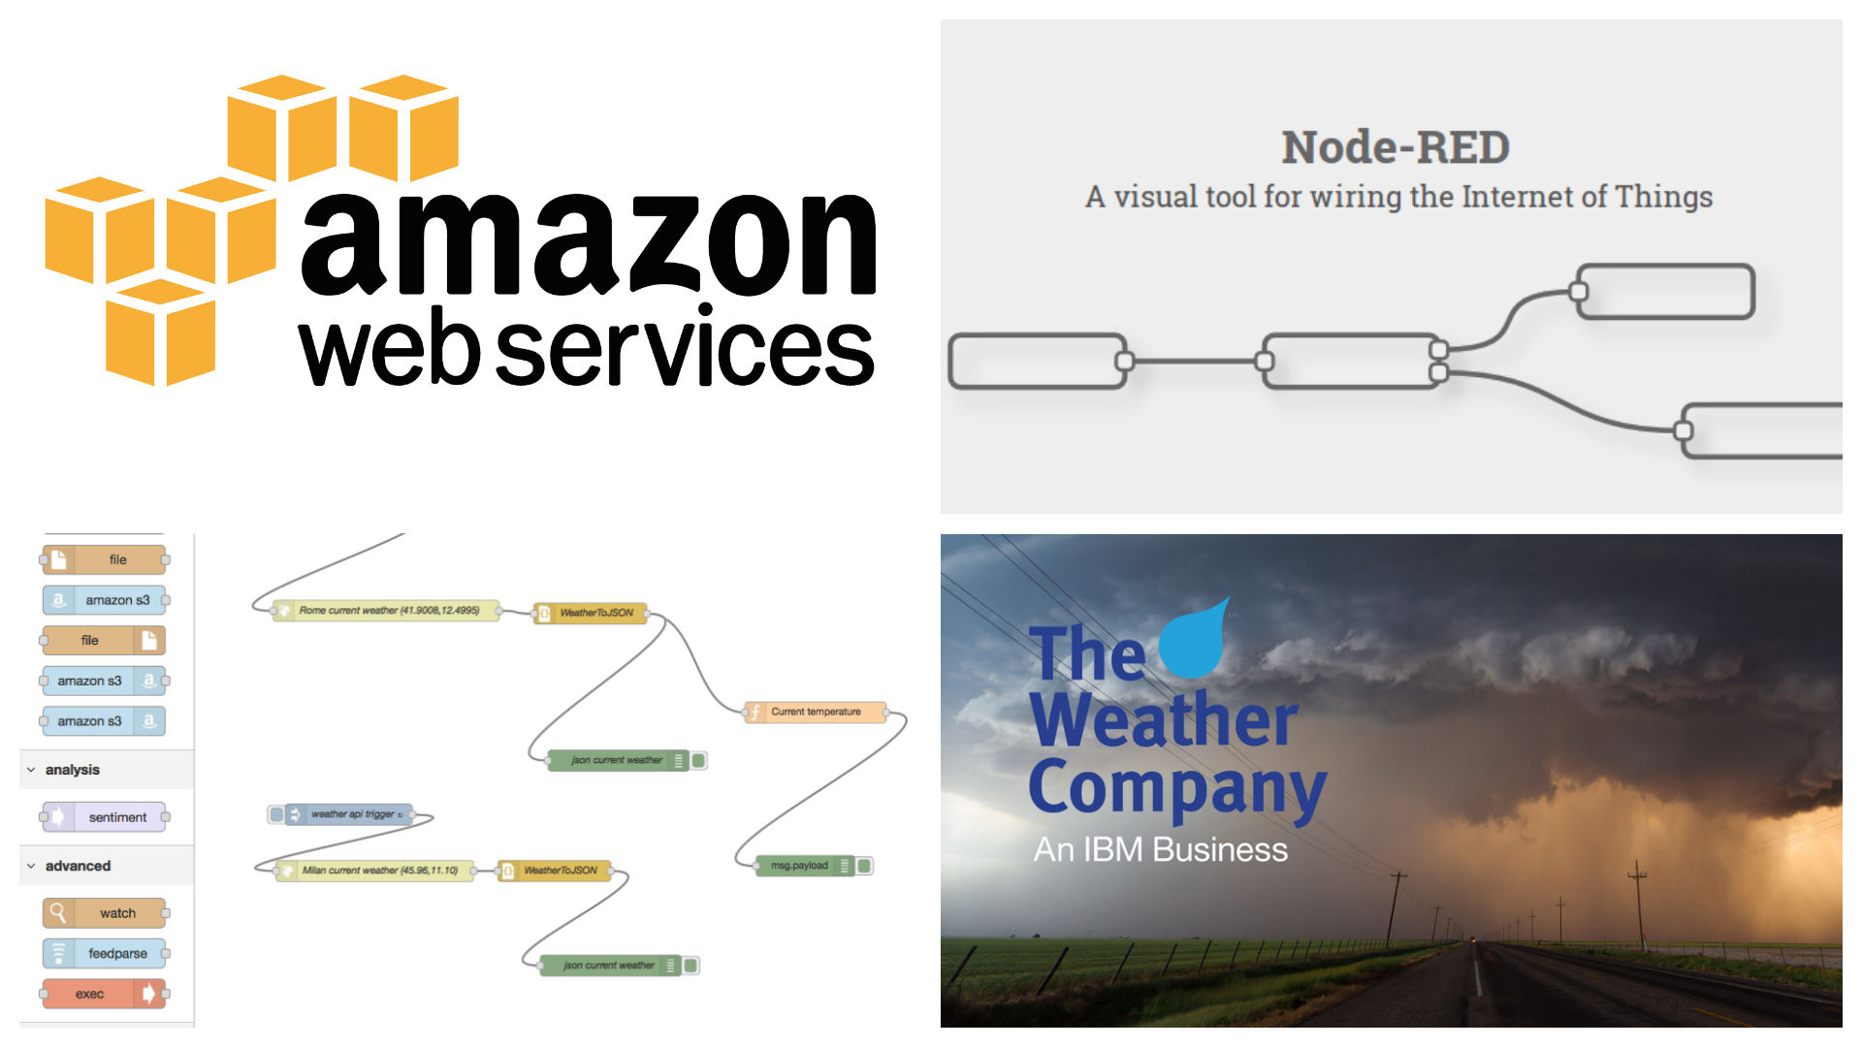
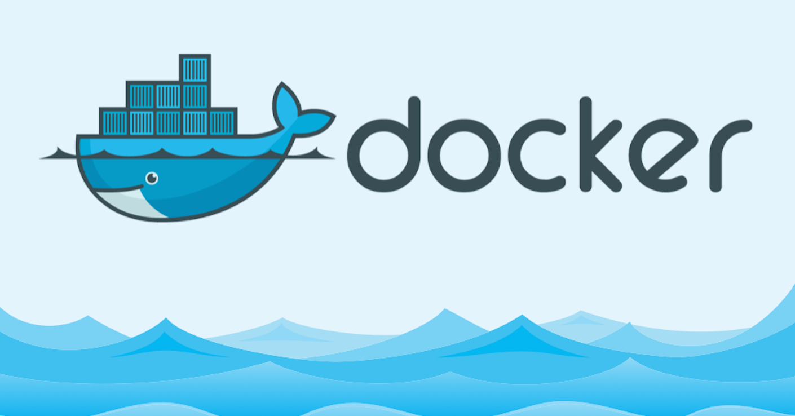

Slide 2

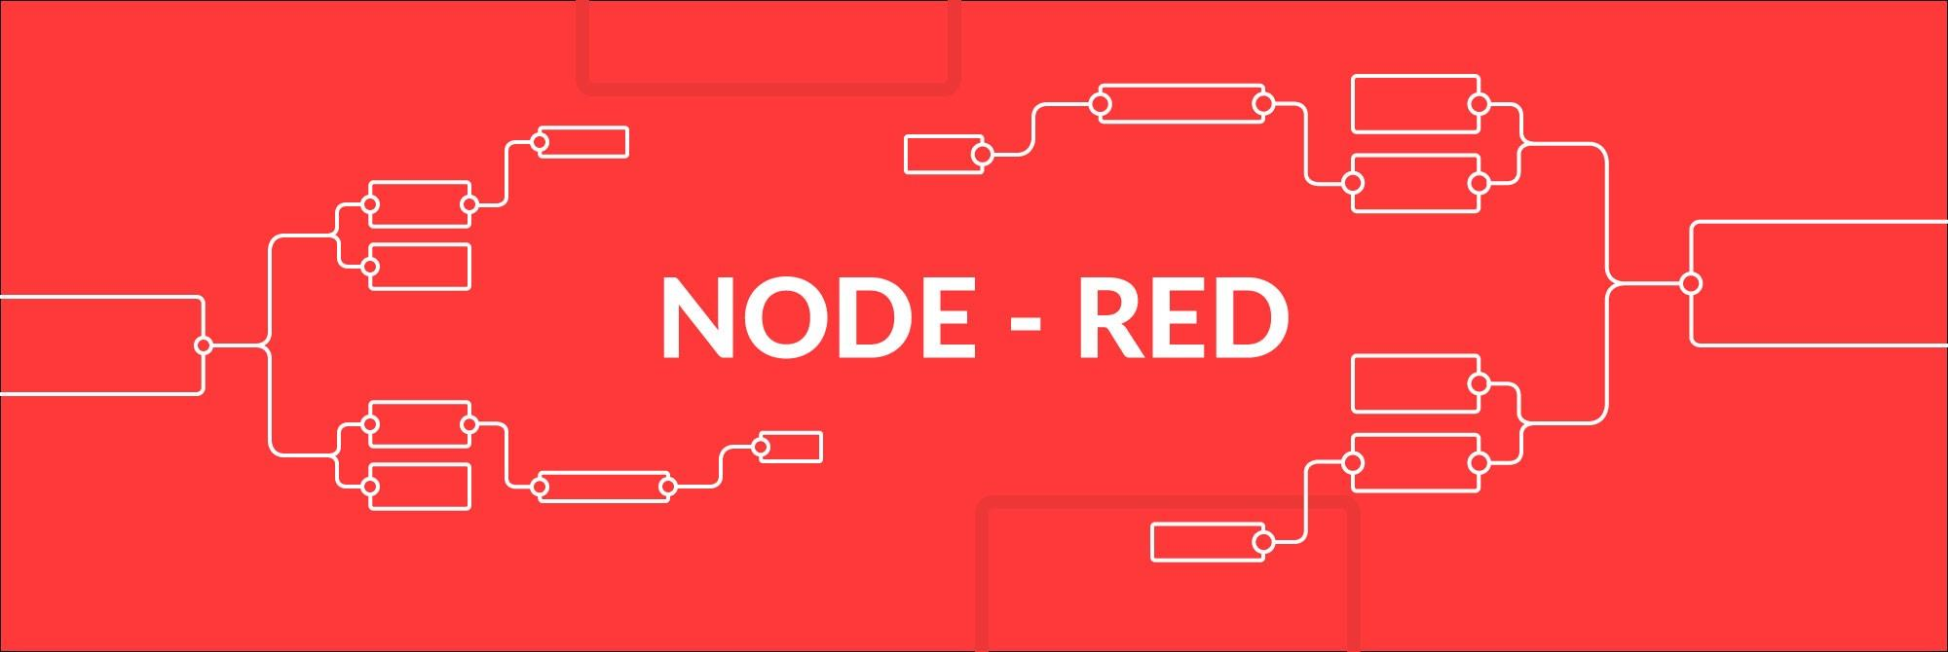
Drag Drop Deploy
Smart Devices do need to talk to servers lying on some cloud. This talk will include basic knowledge of Node-Red framework of Nodejs, Any developer can communicate to devices (publish/subscribe) using MQTT protocol and they can develop any REST APIs using http feature of Node-Red.
Node-Red is drag and drop, light weight framework built upon Nodejs. Now, developer can develop a API in lesser time that he/she takes to make a cup of coffee.

Slide 3
1 - What is Node-RED

Slide 4
Node-RED is visual tool that:
1 – Wires hardware devices, Apis and online services as part of Internet of things
2 – Provides a browser based flow editor
3 – It is built on Node.JS
4 – His flows are stored as JSON

Slide 5
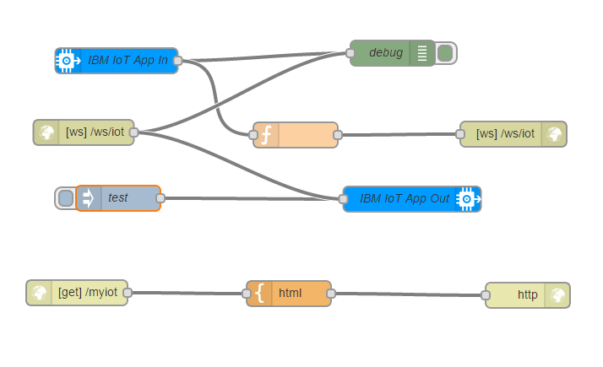
A Step Back : DataFlow Programming
Each block represent a service that we can wire simply extending the wide range nodes in the palette
- The result is a flow of data between each node

Slide 6
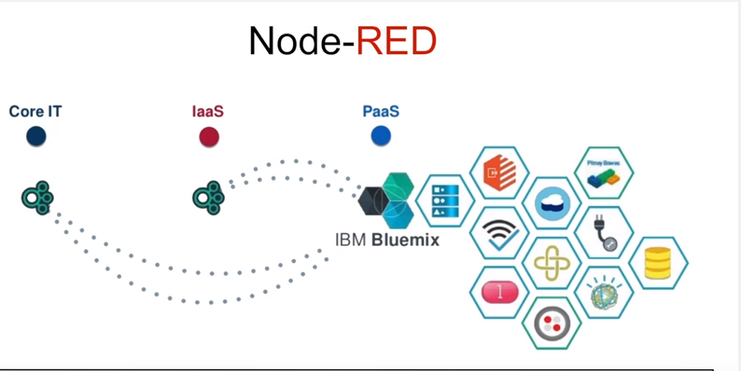
2- Why use Node - RED ?

Slide 7
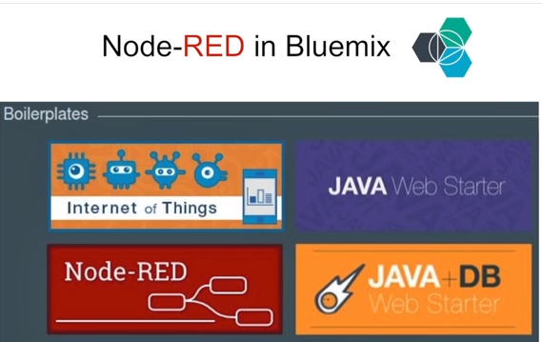
Advantages of Node-RED
h) When Integrated with BlueMix, it provides ready made application templates for different purposes to speed up development. IOT is one of the boilerplates containing Node-red, IOT and time series database already installed
Node Red is open source, can run on low cost hardware, as well as cloud
To run Node-Red we need only node.js and npm installed
Node-Red can easily be run on a Compatible Platform As A Service
It’s based on Node.js, light-weight runtime based on event-driven non-blocking model
Has yet 225,000 modules, and it is easy to add new capabilities
His flows are stored as JSON, so it is language independent
Its Plugin Independent unlike Jenkins

Slide 8
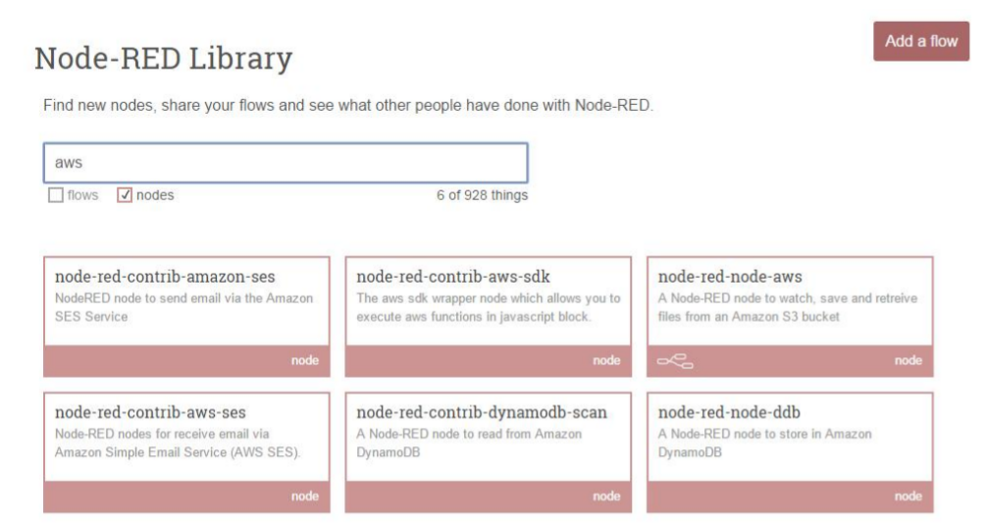
Node Red Nodes for AWS

Slide 9
4- Coding with Node-RED
Every block represents a specific operation:
the blocks are divided by category and can be wired using the flow editor
Nodes represent reusable pieces of code and Logic. Node Red comes with core set of useful nodes .there are growing amount of additional nodes from node-red project as well as wider community and we can program our own nodes using Java Script

Slide 10
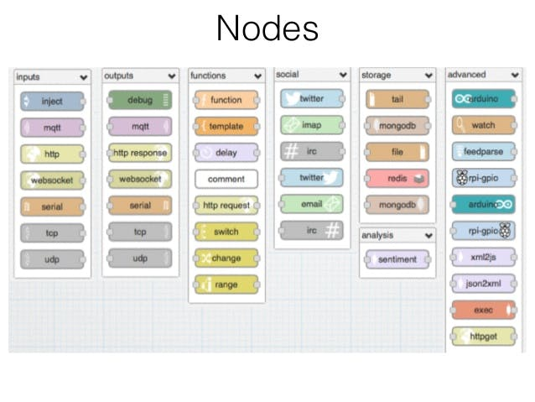

Slide 11
Risk Compliance and Security
In built LDAP node (node-red-auth-contrib-ldap)
It uses oAuthID/OpenID to login using GitHub creds
Password encryption used is BCrypt methodology which use a technique called Key Stretching.
Bcrypt is an adaptive hash function based on the Blowfish symmetric block cipher cryptographic algorithm and introduces a work factor (also known as security factor), which allows you to determine how expensive the hash function will be.
SSL based authentication

Slide 12






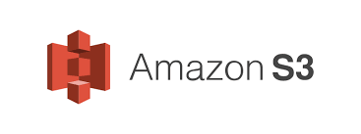



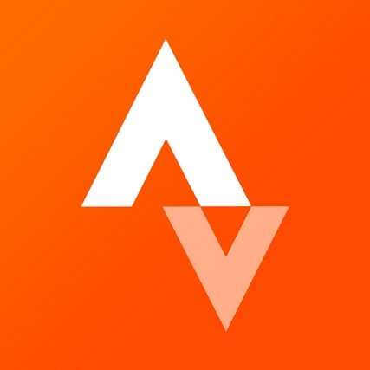

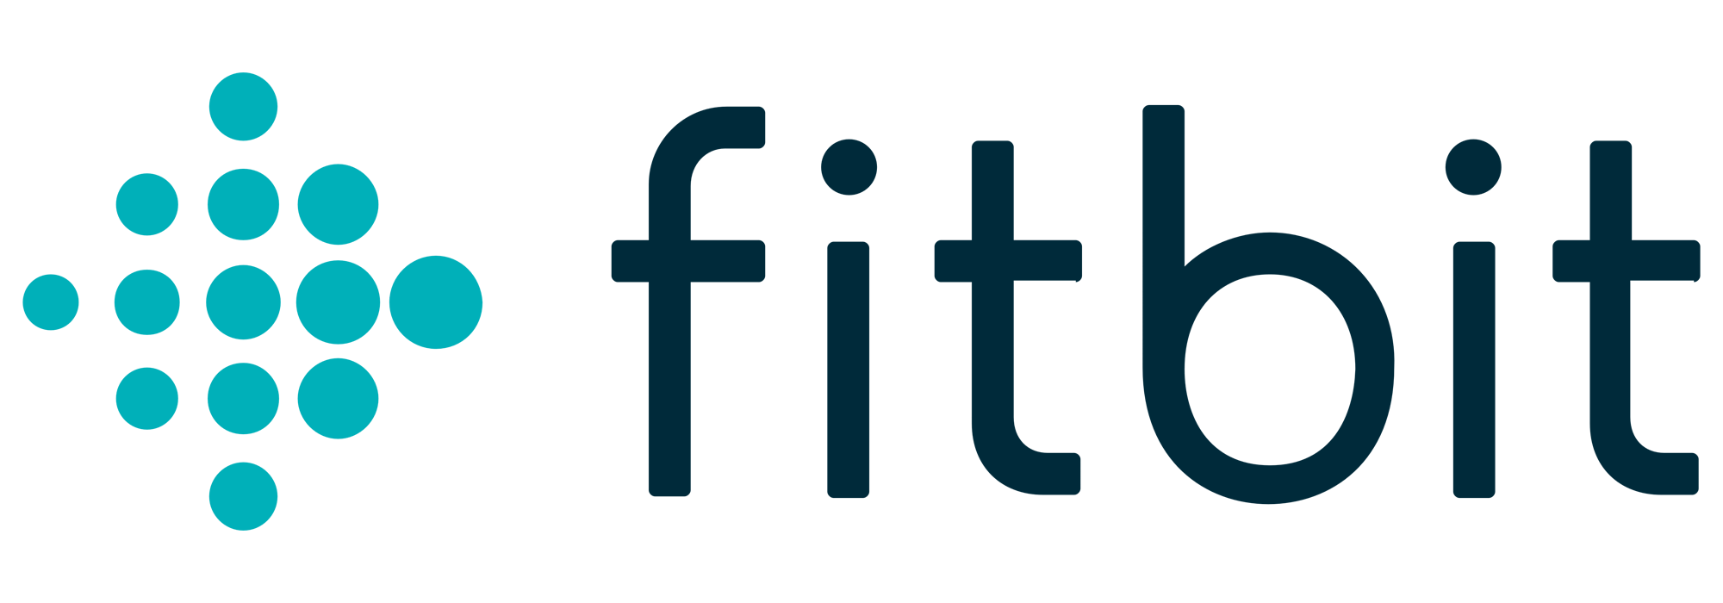
Who are using Node -RED

Slide 13
5 -Node Red Flow and Demo Time !

